Slide 1
EDU GRAPH-API Demo Script
Expertise in Microsoft's Azure, Office 365, and SharePoint platforms

Slide 2
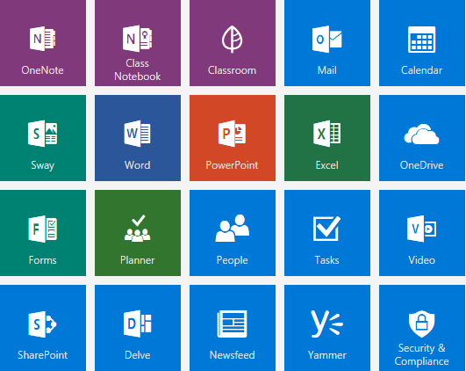
Agenda
Admin Login Authentication Flow
Local Login Authentication Flow
O365 Login Authentication Flow
ALL SCHOOLS
SCHOOL CLASSES
CLASS DETAILS
Teachers/Students
Demo Helper
Sync Data With Web Job

Slide 3
Admin Account Login Authentication Flow

Slide 4
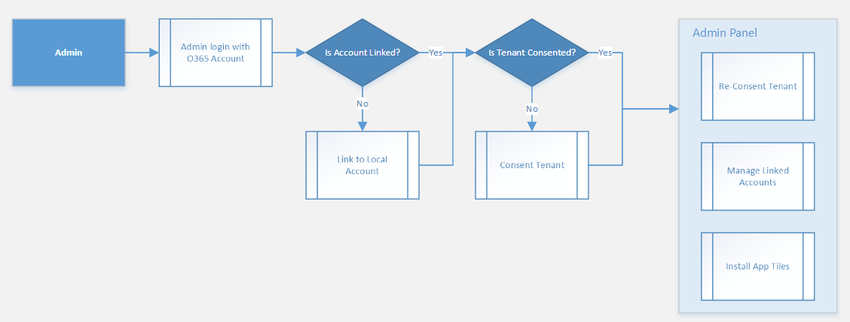
Admin Account Login Authentication Flow

Slide 5
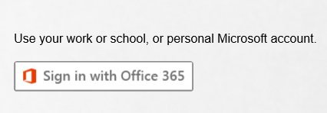
Admin Login with an Office 365 Account
Go to the site login page.
Click the Sign in with Office 365 button.
Login with the Admin account.

Slide 6
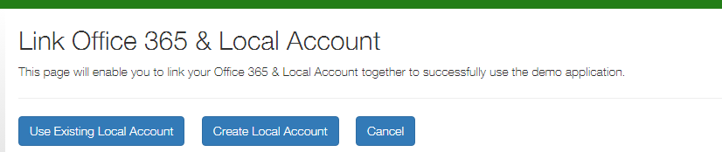
Is Admin Account Linked to a Local Account?
Is the Admin account linked to a local account?
Admin can link use an existing local account.
Admin can create a local account and then link.
Click Cancel button will show a message to tell user that O365 account and local account must be linked..

Slide 7
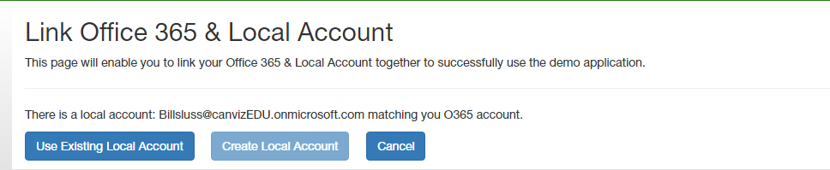
If Account with Same Email Exists
If a local account already exists with the same email as O365 email, Create Local Account will be disabled.

Slide 8
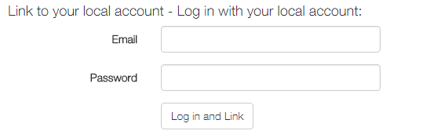
Link the Admin Account to Existing Local Account
If you have a local account, login and then link the local account with O365 account.
After link succeed it will go to all schools page.
Admin can also go to admin panel on top navigation.

Slide 9
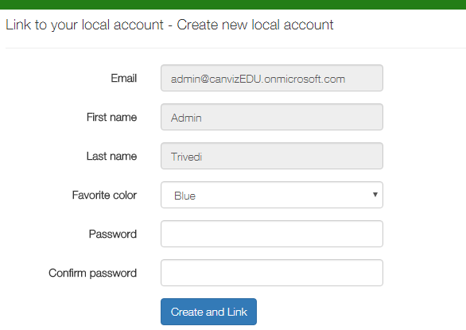
Create Local account and Link
If there’s no local account admin can create a new local account and then link.
Input password and confirm password and then click Create and Link button.

Slide 10
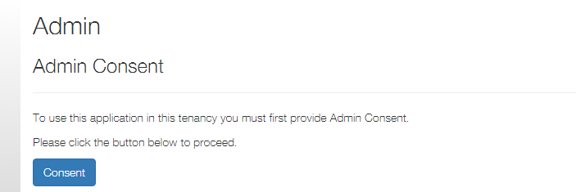
Admin Panel
Admin needs to consent when first go to admin panel.
Click Consent button to login and accept and then consent success.

Slide 11
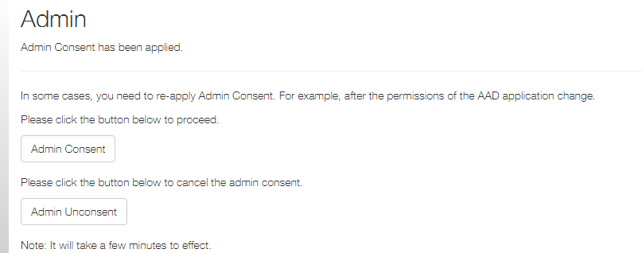
Admin Panel - Admin Consent and Unconsent
Admin can click consent and unconsent buttons to apply/re-apply admin consent.
If clicks consent and unconsent buttons admin needs to login again and then continue.

Slide 12
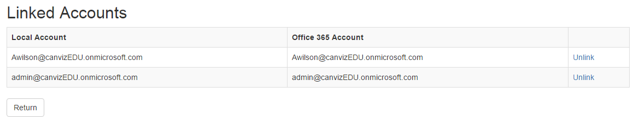
Admin Panel - Manage linked accounts
All linked users are displayed here.
Click the Unlink link to unlink a user.

Slide 13
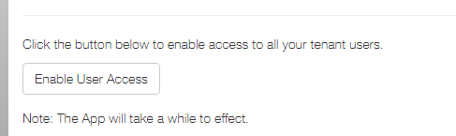
Admin Panel - Enable User Access
Admin can click Enable User Access button to enable access to all tenant users.
It will take a while to effect after the button is clicked.

Slide 14
Local Account Login Authentication Flow

Slide 15
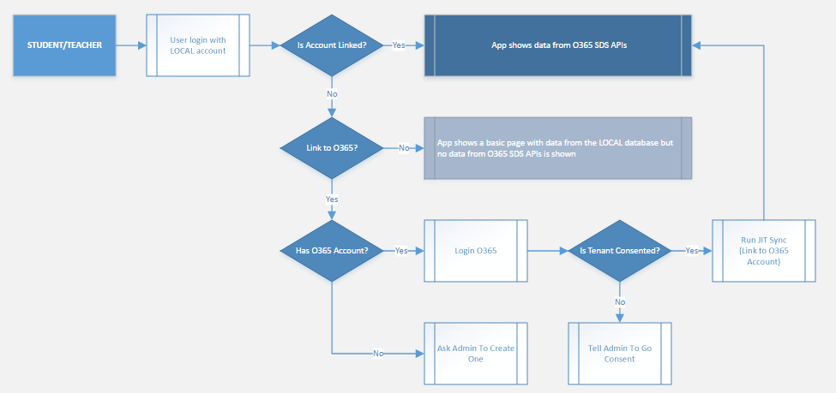
Local Account Login Authentication Flow

Slide 16
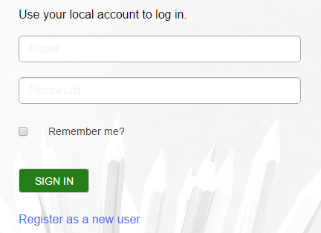
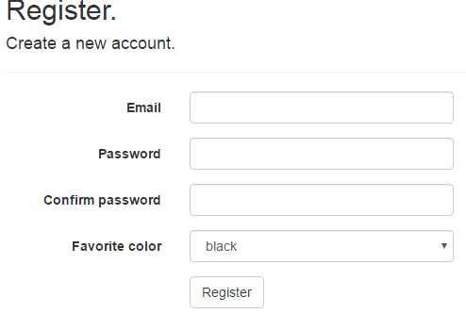
Create Local Account
Go to site login page and click the Register as a new user link.
Fill the form fields: Email, Password etc. , then click the Register button.

Slide 17
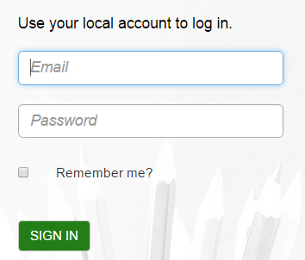
Login with the Local Account
Go to the site login page.
Input email and password.
Click the SIGN IN button.

Slide 18
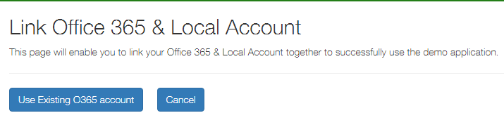
Link the Local Account to an Office 365 Account
Click the Use Existing O365 Account button to login and then link the accounts.
After link succeed it will go to all schools page.
Click the Cancel button to show a basic page and stop.

Slide 19
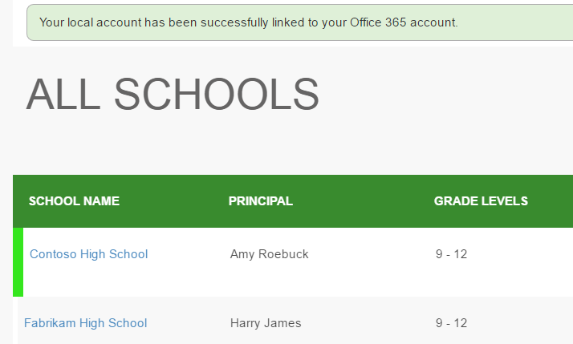
Login succeeded
After linking the accounts succeeds the app displays all schools.

Slide 20
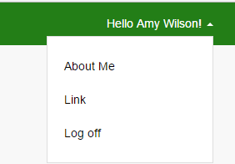
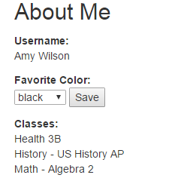
About Me
Click username on top right corner and click “About Me”.
Username will display here.
User’s favorite color will show here and user can change and save it.
If user is linked to O365 his(her) classes will display here.

Slide 21
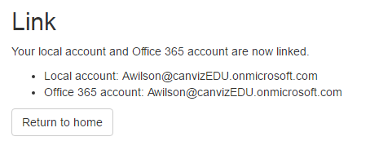
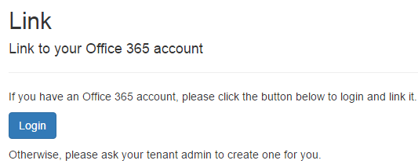
Link
Click username on top right corner and click “Link”.
Here will display link status if account is linked to O365 account.
If local account is not linked to O365 account it will show option “Login” and then link.

Slide 22
Office 365 Login Authentication Flow

Slide 23
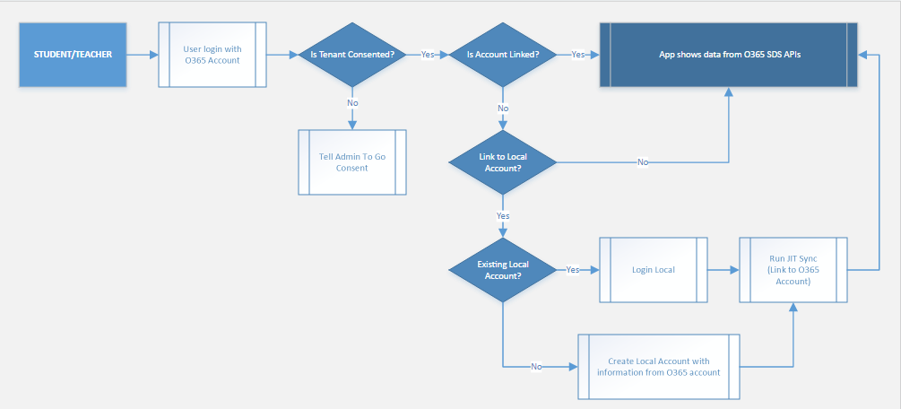
Office 365 Login Authentication Flow

Slide 24
Login with Office 365 Account
Go to the site login page.
Click the Sign in with Office 365 button.
Login with an Office 365 account.

Slide 25
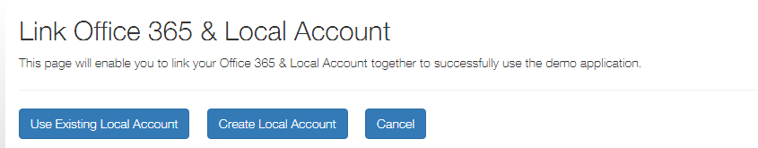
Link an Office 365 Account to a Local Account
Click the Use Existing Local Account button to link the account to an existing account.
Click Create Local account button to create a new local account and then link.
Click the Cancel button to show a message and then stop.

Slide 26
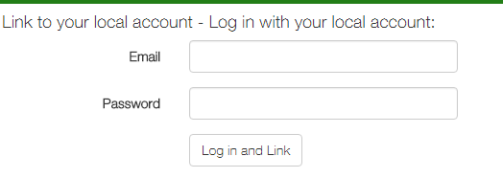
Login with a Local Account and Link the accounts
Input local account’s email and password and then click Login and Link button to link.

Slide 27
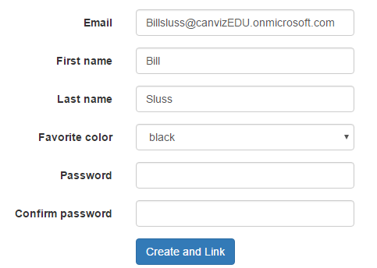
Create a Local Account and Link the accounts
Input the fields Favorite color, Password and Confirm Password.
Select Favorite color.
Click the Create and Link button to create a new local account and then link the accounts.

Slide 28
About Me
Click username on top right corner and click “About Me”.
Username will display here.
User’s favorite color will show here if linked to local account and user can change/save it.
User classes will display here.

Slide 29
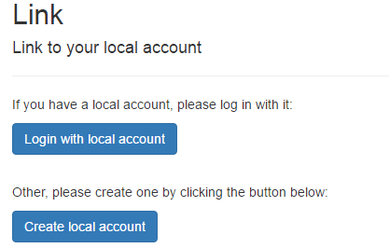
Link
Click username on top right corner and click “Link”.
Here will display link status if account is linked to local account.
If O365 account is not linked to local account it will show link options like “Login with local account” or “Create local account”.

Slide 30
ALL SCHOOLS

Slide 31
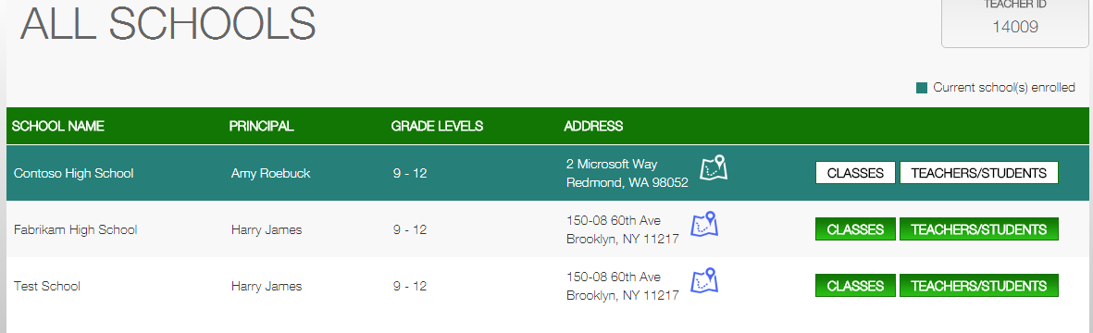
ALL SCHOOLS
Login with a teacher/student account & go to the all schools page.
Teacher/student’s id is displayed in the top right corner.
Current school(s) enrolled are marked with green color.
Click CLASSES to go to the classes page.
Click the Bing map icon to show a map of the selected school.
Click Teachers/students to show teachers/students of current school.

Slide 32
SCHOOL CLASSES

Slide 33
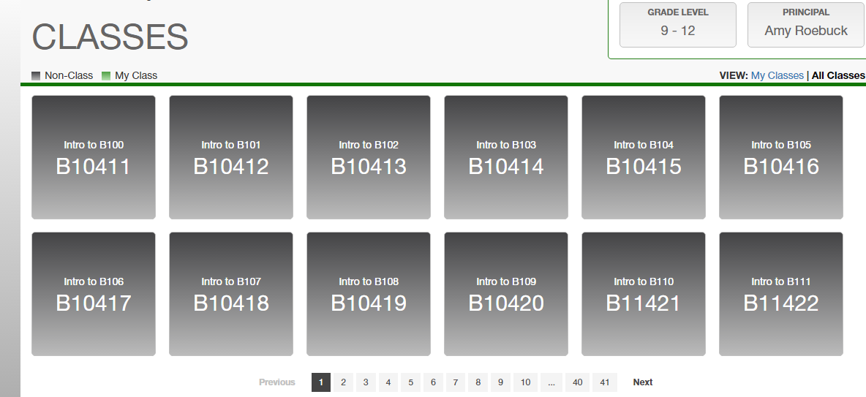
SCHOOL CLASSES
All classes are displayed on the school classes page.
My classes are highlighted with a green color.
Classes that the current users are highlighted with the gray color.
Hover on a class to pop up the class details window.
Click on a green highlighted class to go to the class detail page.
Click the My Classes or All Classes links to switch views.

Slide 34
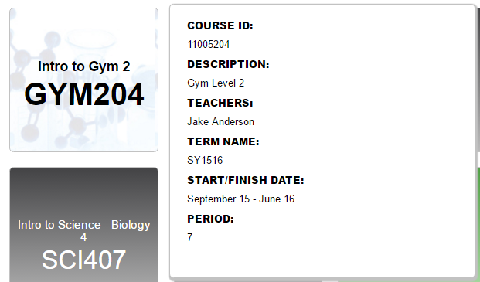
Class detail information
Hover on a class tile to pop up the class detail window.

Slide 35
CLASS DETAILS

Slide 36
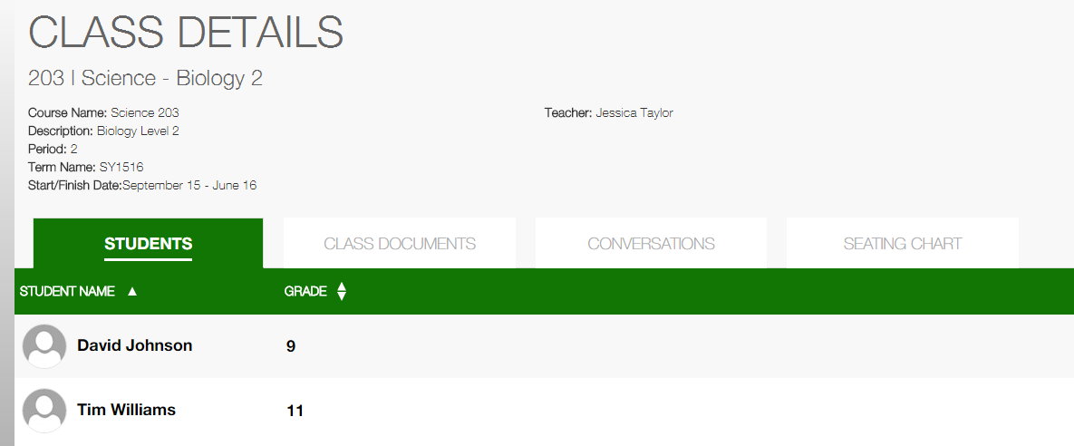
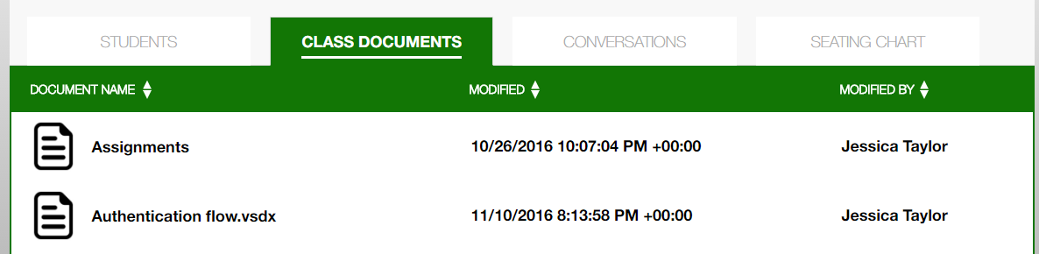
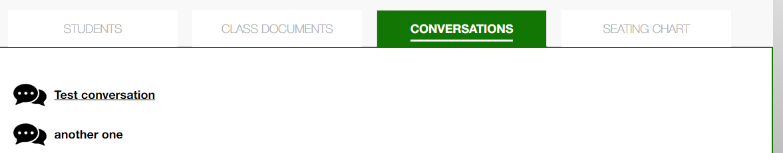
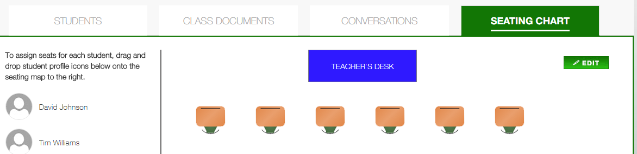
Class detail
Class detail are displayed on this page.
There are 4 tabs containing students, class documents, conversations and seating chart.
Click each tab to see detailed information.

Slide 37
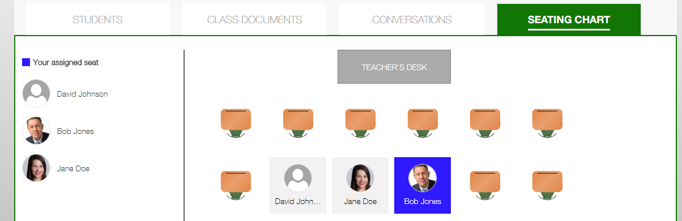
Class detail seating chart – login as a student
When login as a student, his assigned seat will display on the chart.
Current student’s seat will high lighted with the color of his favorite color.
Other students’ seat will show with gray background color.

Slide 38
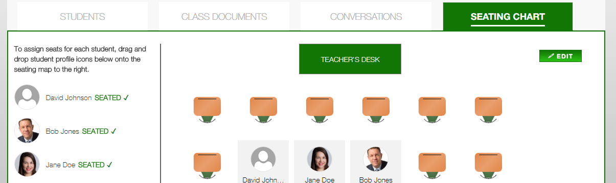
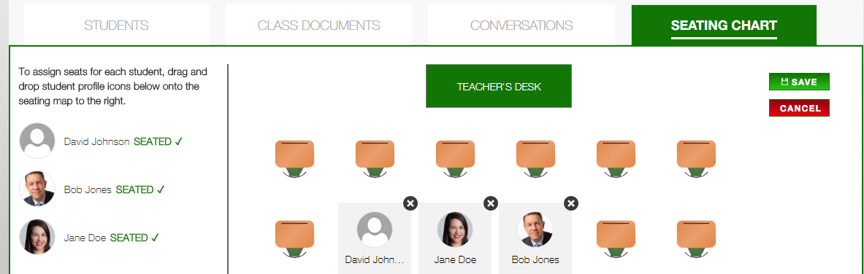
Class detail seating chart – login as a teacher
When login as a teacher, he can see all students’ seat on the chart.
A teacher can click edit button and then drag/drop/delete a student’s seat.
A teacher can save or cancel edit.

Slide 39
Teachers/Students

Slide 40
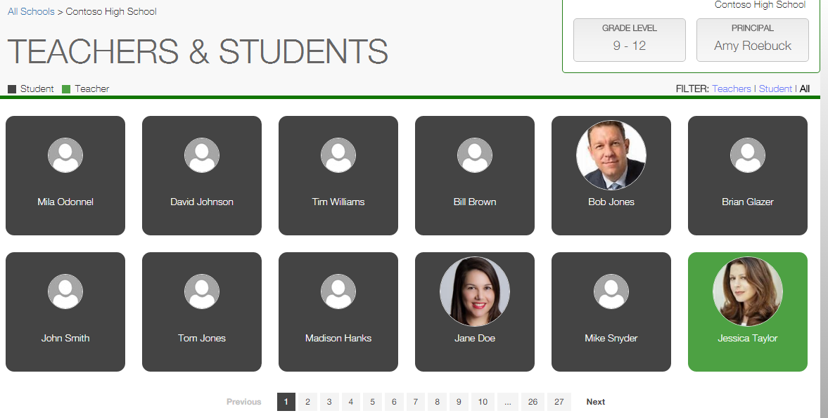
ALL SCHOOLS – Teachers/Students
Click Teachers/students on all schools page and then go to all users page.
All teachers/students will list here.
Click the filter on top right corn to filer teachers/students.
teachers/students will be displayed with paginations.

Slide 41
Demo Helper

Slide 42
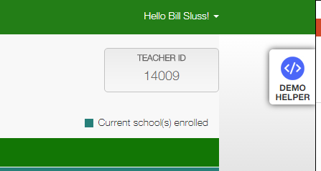
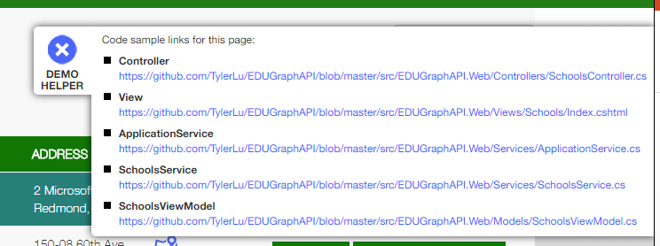
Demo Helper
Click Demo Helper on top right corner to open helper.
It will show information like Controller, View, Services, ViewModel of current page.
Click X to hide helper.

Slide 43
Sync Data With Web Job

Slide 44
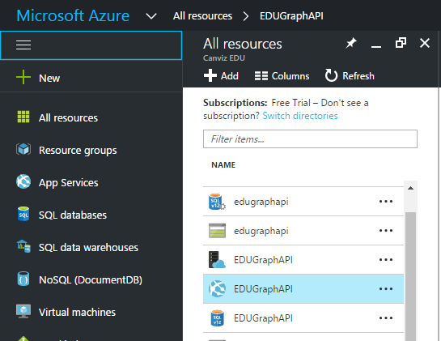
Sync Data With Web Job
Got to https://portal.azure.com and login with the admin account.
Click All resources on the left side of the page. All resources are displayed.
Click the App Service named EDUGraphAPI.

Slide 45
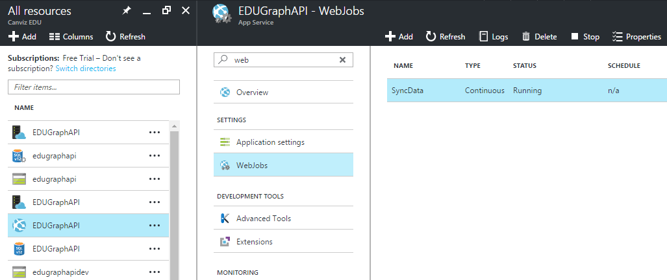
Web Jobs
In the Settings group, click Web Jobs.
Select the job named SyncData, then click Logs.

Slide 46
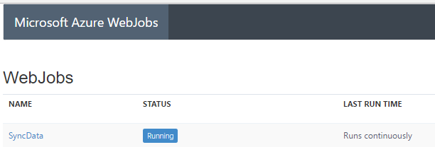
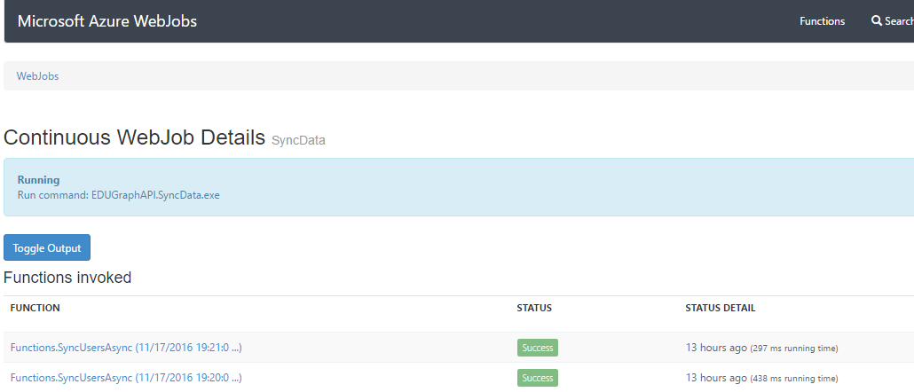
Web Job Logs
Click the SyncData link to see Log details.
On Log detail page click the Toggle Output button to show Log details.

Slide 47
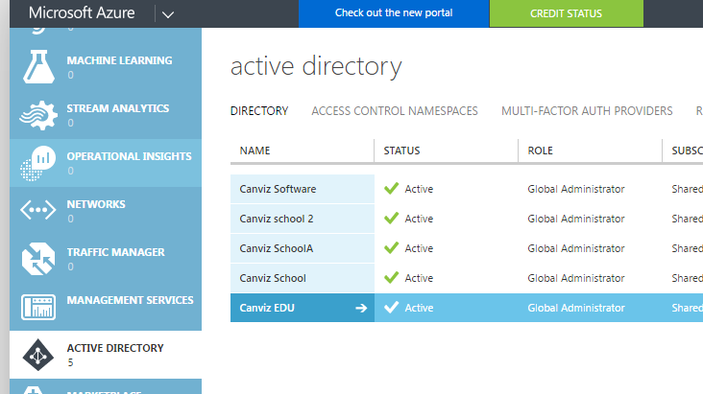
Update AD User Information
Go to https://manage.windowsazure.com/ and login with the admin account.
Click ACTIVE DIRECTORY in the left menu.
Click the AD named Canviz EDU.

Slide 48
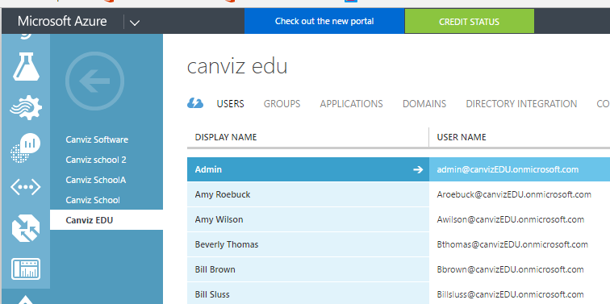
Update AD User Information
Click the Users link to show all the users in the AD.

Slide 49
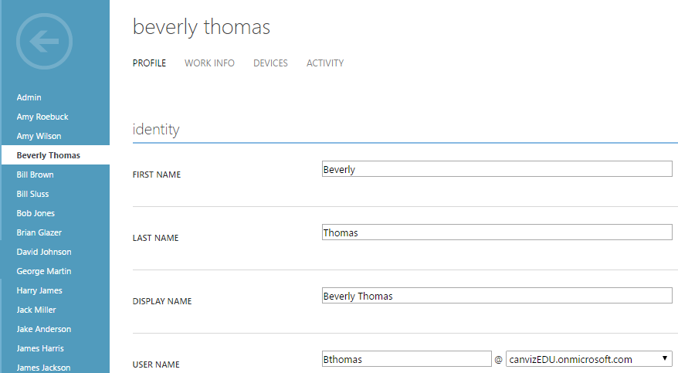
Update AD User Information
Click a user and open the edit page.
Update user information like First name or Last name.
Save the changes.
Notice:
An O365 user can only be synced after linked with a local account.
Only properties of Department, JobTitle and Mobile can be synced.

Slide 50
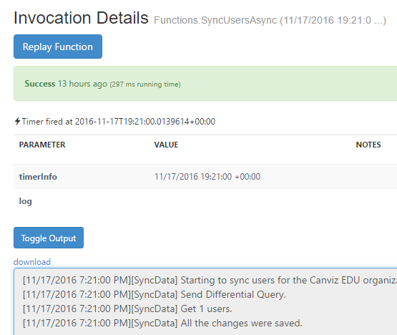
Check Web Job Sync Result
Go back to web job log detail page.
Wait about 1 minute, then refresh the page.
Click the last function invoked to open the detail page.
Click the Toggle Output button.
View the log that shows one item was updated.

